Slide 1





FINSPIRE
ROOKIETECHIES

Slide 2


PROBLEM
Develop a fintech solution that promotes financial literacy and education among youth to equip them with essential money management skills. Many young individuals lack fundamental knowledge about personal finance, which can lead to poor financial decisions and long-term consequences. This challenge focuses on creating engaging and accessible fintech tools or platforms that educate young people about topics such as budgeting, saving, investing, and responsible borrowing.
PROBLEM STATEMENT -07

Slide 3


SOLUTION
Our fintech solution leverages AI-driven language processing to analyze financial stories and market trends. Users interact with the system, receiving personalized investment recommendations and insights into stock performance and future demand. Empowering investors with informed decisions, we bridge the gap between complex financial data and actionable insights.

Slide 4




SERVICES
Personalized Recommendations
Financial Story Interpretation
Market Trend Analysis
Tailored stock suggestions based on user preferences, risk tolerance, and financial goals.dience.
Insights into current market trends and predictions on future stock performance.
Ability to understand and analyze financial news, reports, and narratives to extract valuable insights.

Slide 5



SERVICES
Risk Assessment
Portfolio Optimization
Real-time Updates
Evaluation of investment risks associated with specific stocks or market conditions.
Recommendations to optimize investment portfolios for better diversification and returns.
Timely updates on stock market movements, news, and events impacting investment decisions.

Slide 6


SERVICES
Scenario Analysis
Educational Resources
Assessing hypothetical scenarios and providing potential outcomes on stock investments.
Access to educational materials and tutorials on financial concepts and investment strategies.

Slide 7


S (Strengths) | W (Weaknesses) | O (Opportunities) | T (Threats)
Advanced AI Technology Personalized Recommendations Multilingual Chat Support Real-time Updates | Data Accuracy Language Processing Limitations User Trust Building Market Volatility Impact Competitive Landscape Challenges | Global Expansion Partnerships Technological Advancements Regulatory Changes Diversification | Security Risks Legal Compliance Economic Instability Technological Disruption User Resistance

Slide 8

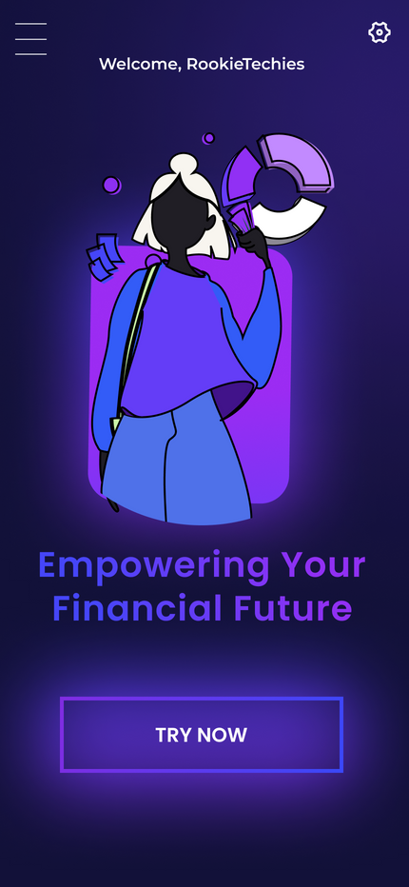
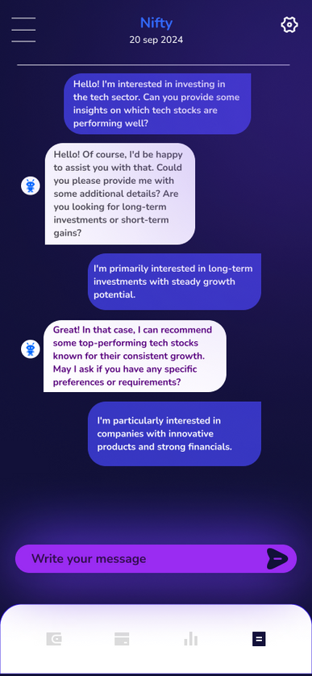
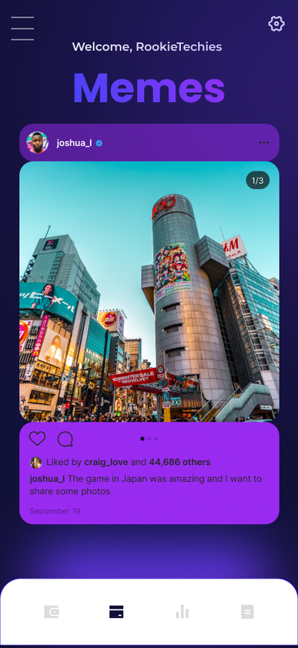

UI INTERFACE

Slide 9
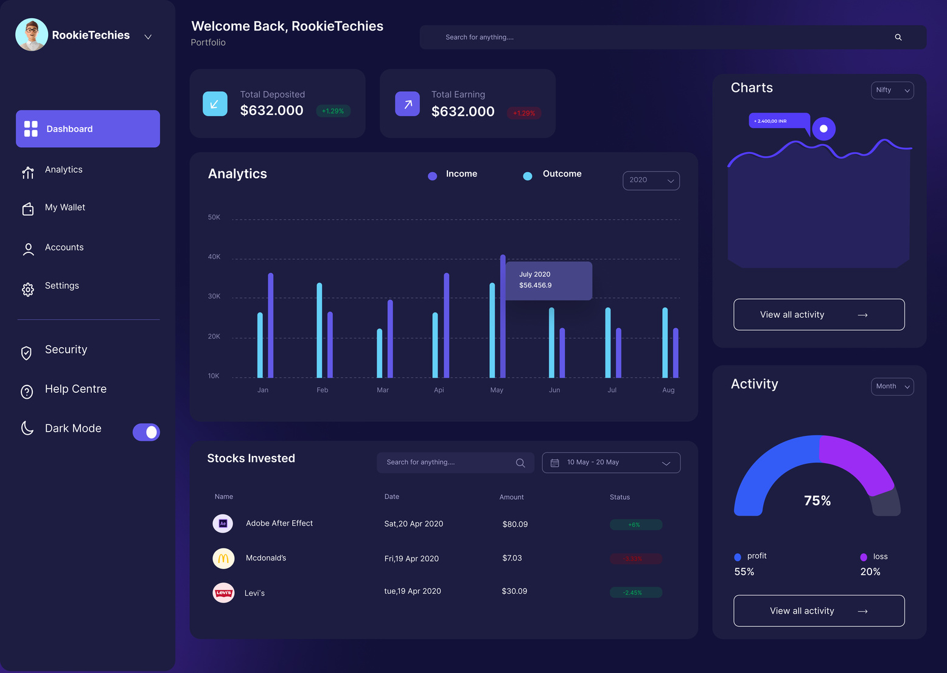
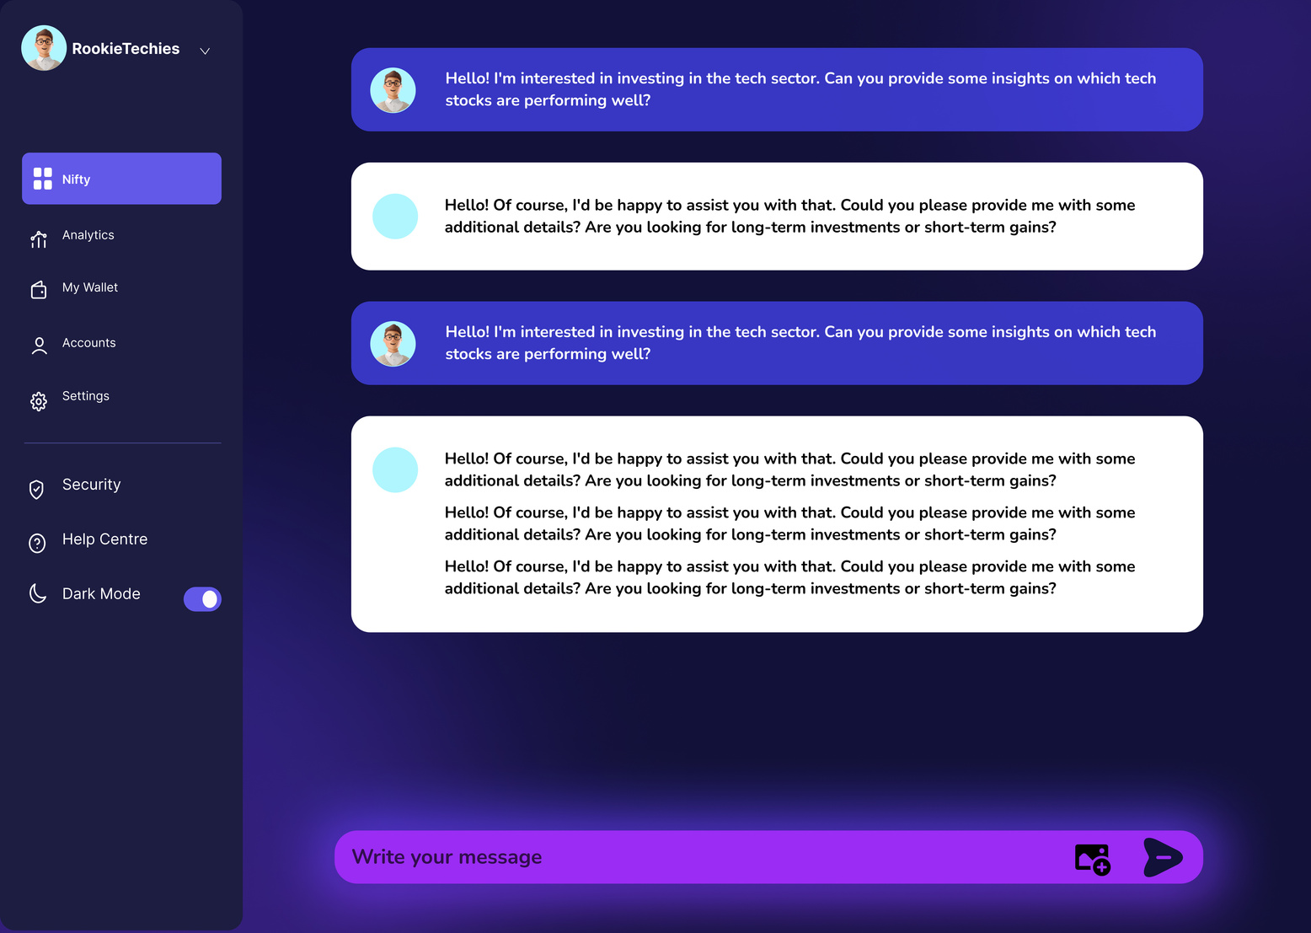
UI INTERFACE

Slide 10
Graphical Representation
FLOWCHART
Portfolio Optimization
Risk Assesment
LOGIN/SIGN UP
How To invest
Document Learning
Personalized Recommendations
Chat Bot
Scenario Analysis
Financial Story Interpretation

Slide 11


FUTURE VISION
Enhanced LLM Model Accuracy:
Multilingual Chat Support
Implement advanced algorithms & techniques, like reinforcement learning or self-learning mechanisms, to enhance the model's ability
Offering the ability for users to interact with the system in multiple languagesrse user base.

Slide 12




Business Models
Subscription
Freemium
Subsidized
Charge customers a monthly or annual subscription fee to use your software
Free version of your software with limited features, & charge customers for a premium with additional features
Providing subsidies for human wellfare campigns

Slide 13



TARGET AUDIENCE
"Our target audience comprises individuals with limited market knowledge, seeking an intuitive platform that simplifies complex financial concepts and provides concise, easy-to-understand answers and Someone who values time-saving solutions and prefers summaries"
Potential Users
Young professional
Stay-at-home parent
Tech-savvy but finance-averse

Slide 14
MARKET ADOPTION
Education and Awareness: Launching educational campaigns to increase awareness about the platform's benefits. This includes workshops, webinars, tutorials, and informative content
User-Friendly Interface: Ensuring that the platform is user-friendly and intuitive, making it accessible even to those with minimal market knowledge.
Personalized Onboarding: Providing personalized onboarding experiences for new users, including guided tours, tutorials, and tailored recommendations
Partnerships and Collaborations: Forming strategic partnerships with financial institutions, educational organizations, and influencers in the finance industry to increase visibility and credibility.

